Slide 1

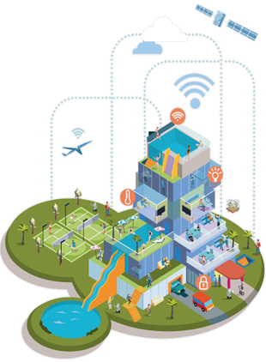


SafeAid
Presented by:
Saeed Maya Saeed Ibrahim, Khin Moe Moe Latt, Thon Than Thar
부산대학교 정보의생명공학대학
정보컴퓨터공학부
Adventure Design

Slide 2


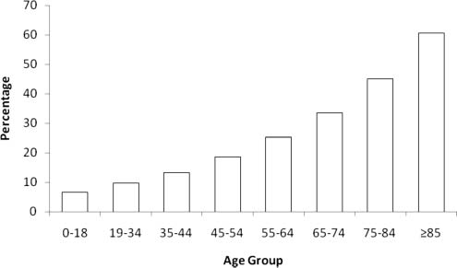
Development Background
Percentage of patients arrived by emergency medical services by age
‹#›

Slide 3
Development Background
High Emergency Risk Among People Aged 60 and Above:
People over the age of 60 have a significantly higher risk of medical emergencies, such as sudden falls and heart-related problems.
Statistics show that the percentage of emergency incidents increases rapidly after the age of 60, making continuous monitoring essential.
Many emergencies occur unexpectedly and without warning.
Falls as a Major Cause of Serious Injury
Falls are one of the most common emergencies among elderly people.
A fall can lead to fractures, head injuries, or long-term disability.
In many cases, the injured person is unable to move or call for help after falling.
Delayed Emergency Response
When an emergency is not detected immediately, the response time increases.
Delayed medical assistance can result in worsened health outcomes or death.
Immediate detection and alerting are critical to reducing damage.
Need for Automatic Emergency Detection
In emergency situations, elderly individuals may be unconscious, confused, or physically unable to press a button or ask for help.
An automatic system that detects emergencies without user interaction is essential.
Such a system improves safety and provides reassurance to both users and their families.
‹#›

Slide 4
Development Objectives
Ensure Rapid Emergency Detection
To develop a system that can automatically detect emergency situations, such as falls and abnormal heart rates.
To minimize the time between an emergency event and its detection.
Improve Safety for Elderly Users
To enhance the personal safety of people aged 60 and above, who are at higher risk of medical emergencies.
To provide continuous monitoring without interfering with daily activities.
Enable Immediate Emergency Alerts
To design a system that automatically sends emergency alerts when an abnormal condition is detected.
To ensure that help can be requested even when the user is unable to respond manually
Provide Real-Time Health Monitoring
To continuously monitor vital signs, especially heart rate, in real time.
To detect abnormal patterns that may indicate health risks.
Develop a Low-Cost and Efficient System
To build a system using affordable hardware components.
To ensure the system is energy-efficient, reliable, and easy to use.
‹#›

Slide 5
Team Member Contributions
Khin Moe Moe Latt:
Soldering and assembly of Arduino sensors
Circuit design and hardware connections
Saeed Maya Saeed Ibrahim:
Software development and code implementation
System logic and sensor data processing
Thon Than Thar:
KakaoTalk application setup and integration
Emergency notification configuration
‹#›

Slide 6
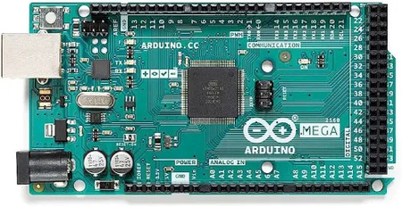
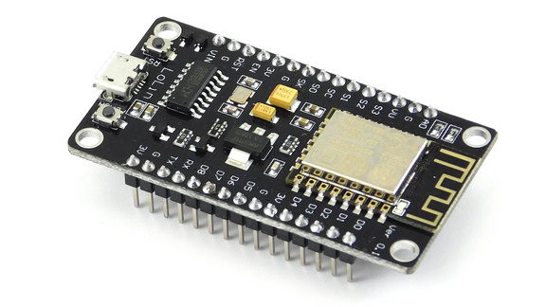
Hardware Components
1. Processing & Connectivity
Arduino Mega 2560: Master Controller; manages sensor data and emergency logic.
ESP8266 (NodeMCU): Communication Gateway; handles Wi-Fi and KakaoTalk API.
‹#›

Slide 7
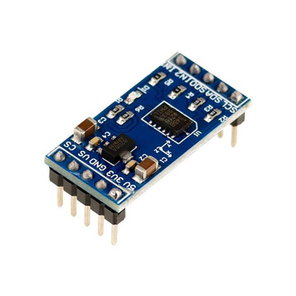
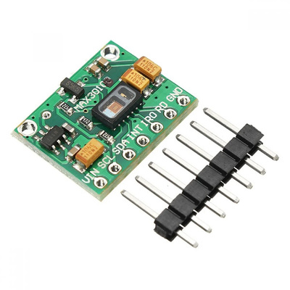

Hardware Components
2. Sensing Suite
ADXL345 Accelerometer: Detects physical movement, free-fall, and impact.
MAX30102 Heart Rate Sensor: Optical IR sensor for real-time BPM monitoring.
3. User Interface
SOS Push Button: Manual override for instant emergency triggering.
‹#›

Slide 8


Hardware Components
ADXL 345
Accelerometer
I2C bus(SDA,SDL)
Serial UART(TX,RX)
MAX 30102
Heart Rate Sensor
Arduino Mega 2560
(Master Controller)
ESP 12e
(Wifi Module/ Communication Gateway)
Momentary Button
Digital Signal
Serial Monitor
Acc: x.xx, Avg bpm: xxx
Kakao API Notification
(User Caregiver Phone)
‹#›

Slide 9

Demonstration Video
‹#›

Slide 10
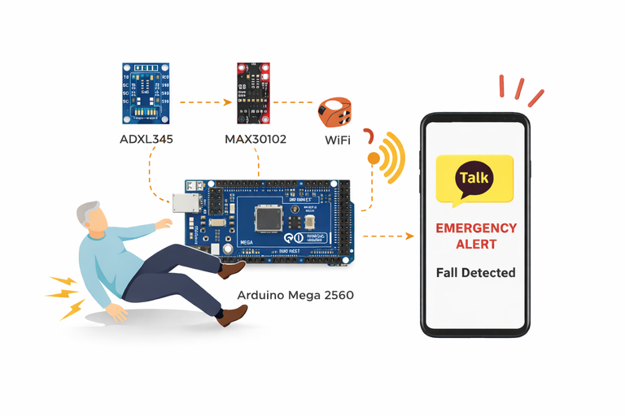
Expected Impact
1. Our System automatically detects emergencies
Fall detection
Abnormal heart rate
SOS button
Instant KakaoTalk alert sent to caregivers
Faster response time in emergencies
Improves safety, independence, and peace of mind
‹#›

Slide 11
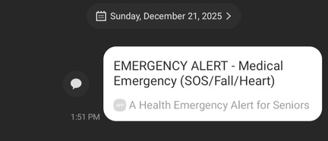
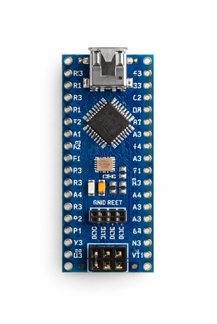
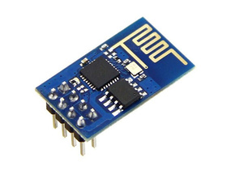
Conclusion
◆ Smart health emergency alert system
◆ Uses Arduino, health sensors, and Wi-Fi
◆ Detects : Falls, Abnormal heart rate, Manual SOS
◆ Sends real-time emergency alerts via KakaoTalk
◆ Shows practical use of IoT in healthcare
Future Works
Reduce device size with Arduino Nano R3, ESP8266-01
Add 3D-printed wearable case
Emergency cancel button with follow-up alert
Add health features: Step counting, Exercise time
Add display or Blynk app
- View health data, Past emergency alerts, Edit emergency contacts
Send SMS with user location for faster rescue
‹#›

Slide 12
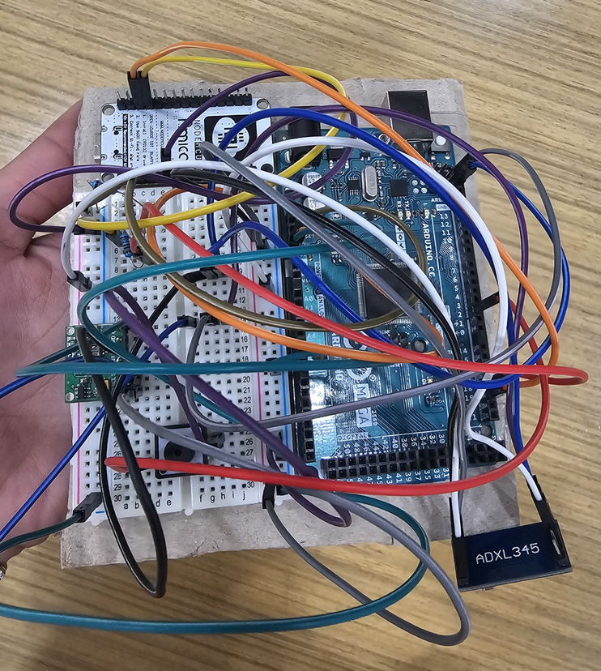
Questions & Answers
🚨Smart Emergency Alert System for Elderly Care
“We care for senior safety”
Adventure Design

